Slide 2
Methode
Uitvoeren vier paired t-Tests,
Nulhypothese:
Gemiddelde van het verschil tussen de paren is nul
Alternatieve hypothese:
Het gemiddelde van het verschil tussen de paren is niet nul

Slide 3
set.seed(42)n_users <- 100user_id <- paste0("user", 1:n_users)A_version <- rep(c("A1", "A2", "A3", "A4"), each = 25)B <- sample(1:100, n_users, replace = TRUE)A <- numeric(n_users)for (i in 1:n_users) { if (A_version[i] == "A3") { # For A3, make A far from B: if B < 50, A is high (100); if B >= 50, A is low (1) A[i] <- if (B[i] < 50) 100 else 1 } else { # For A1, A2, A4, make A close to B (within ±5 points) epsilon <- sample(-5:5, 1) A[i] <- min(100, max(1, B[i] + epsilon)) }}Simulation <- data.frame( slider_values = c(rbind(B, A)), # Interleave B and A scores article_number = c(rbind("B", A_version)), # Interleave "B" and A_version user_id = rep(user_id, each = 2) # Repeat each user_id twice)Simulation <- Simulation[order(Simulation$user_id), ]write.csv(Simulation, "Simulation.csv", row.names = FALSE)

Slide 4
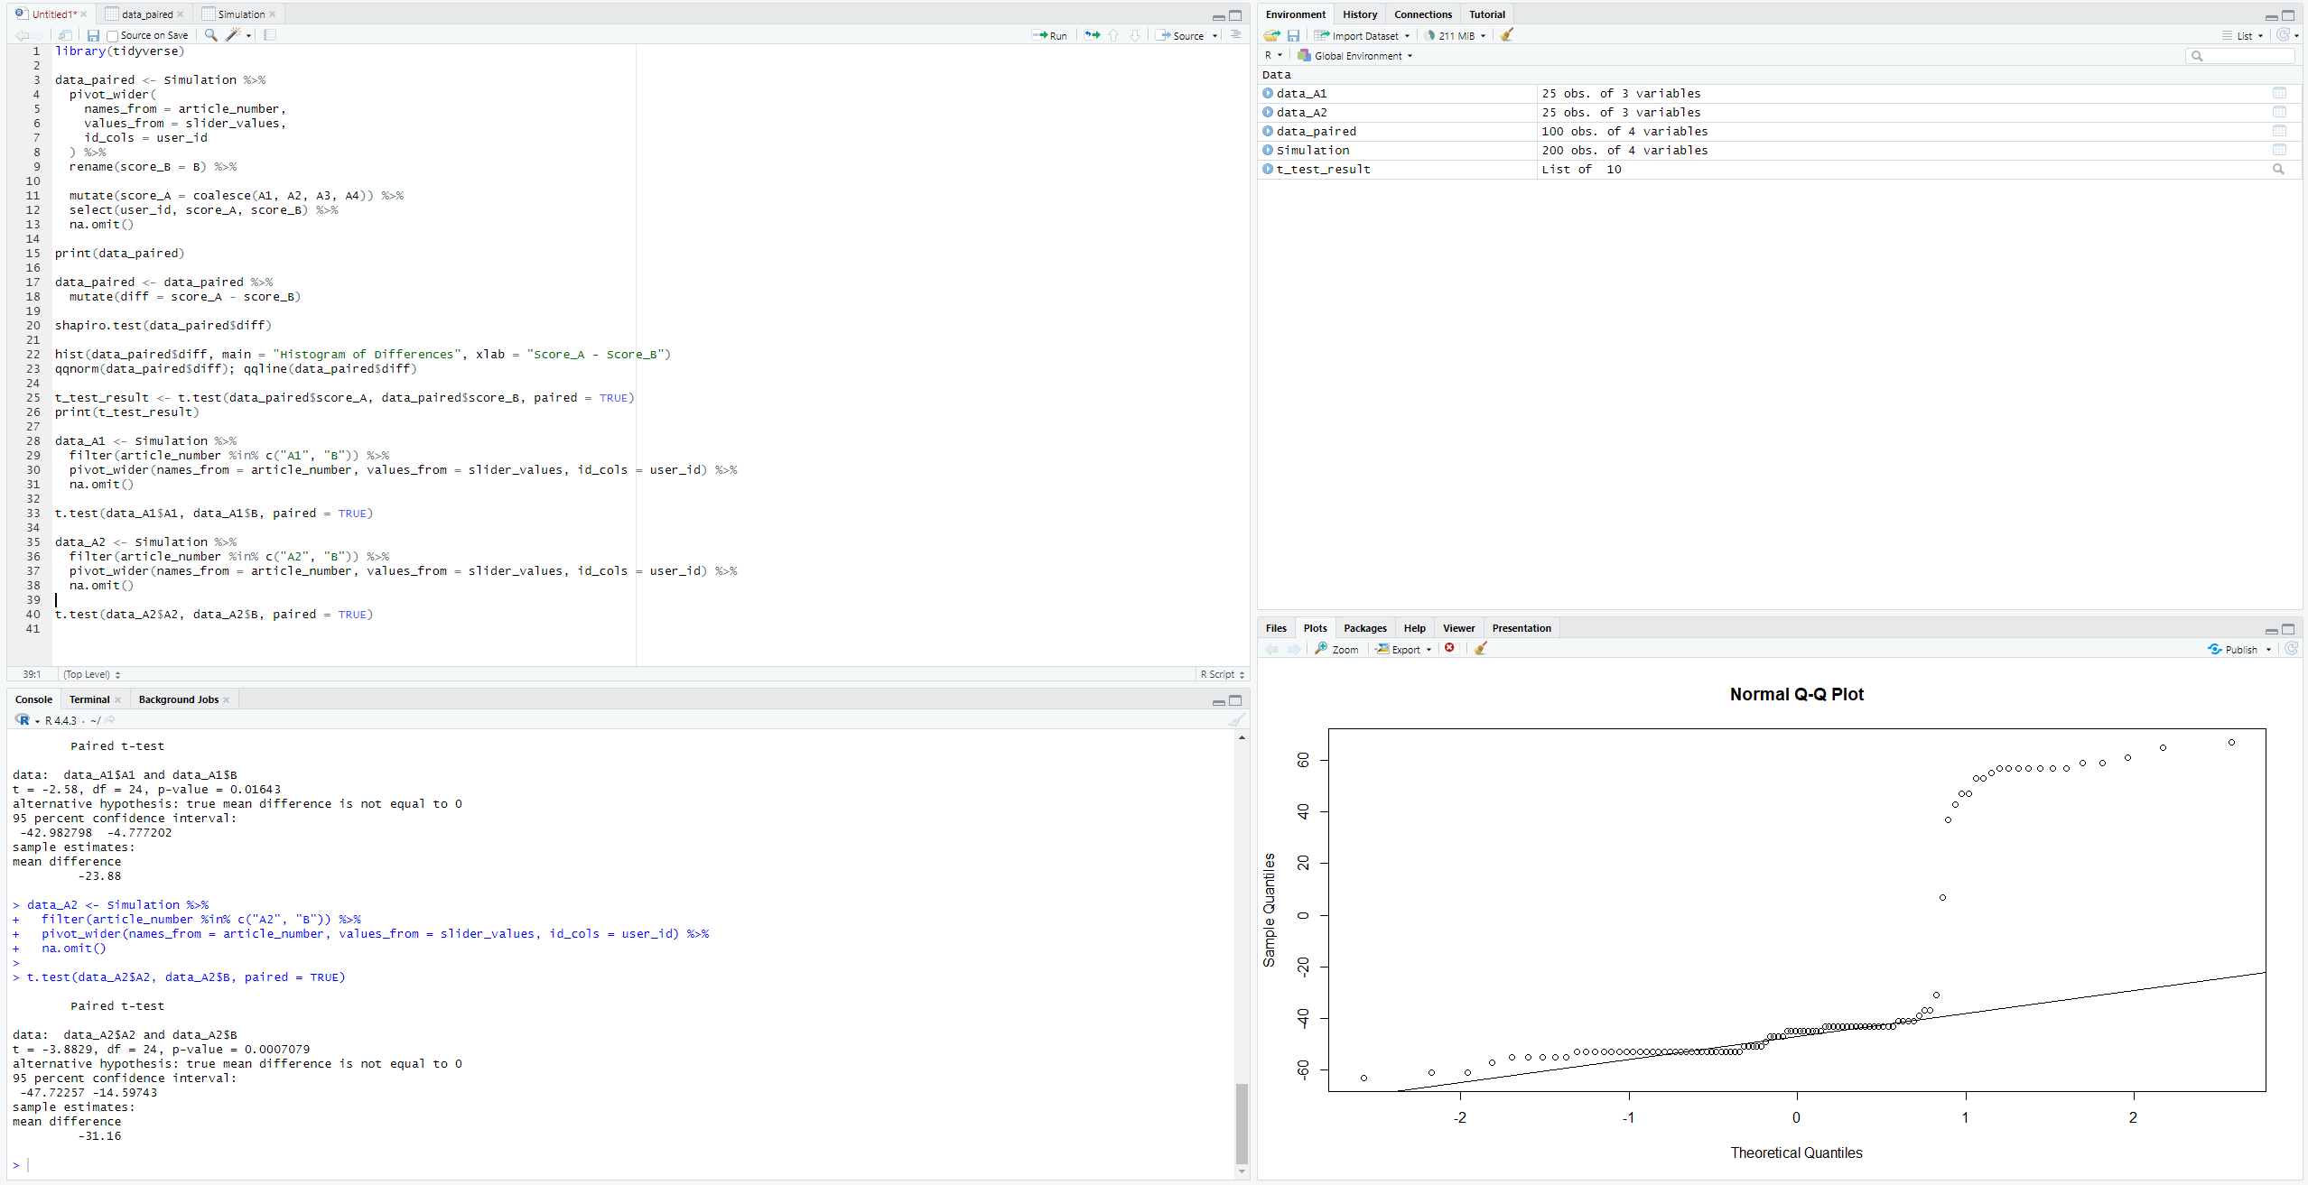

Slide 5
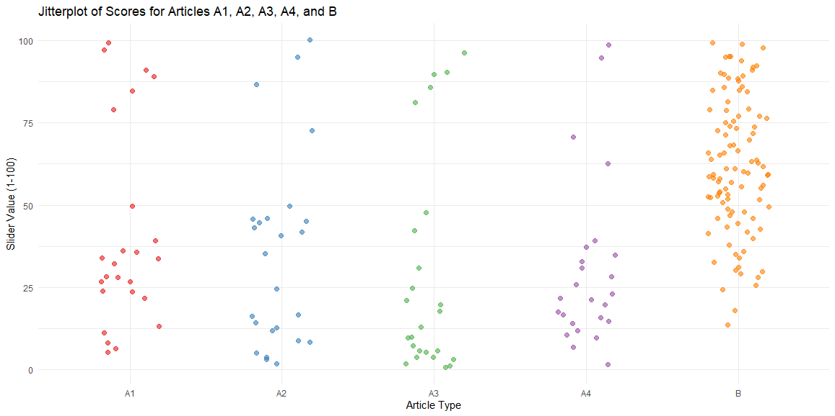
-24.92

Slide 6
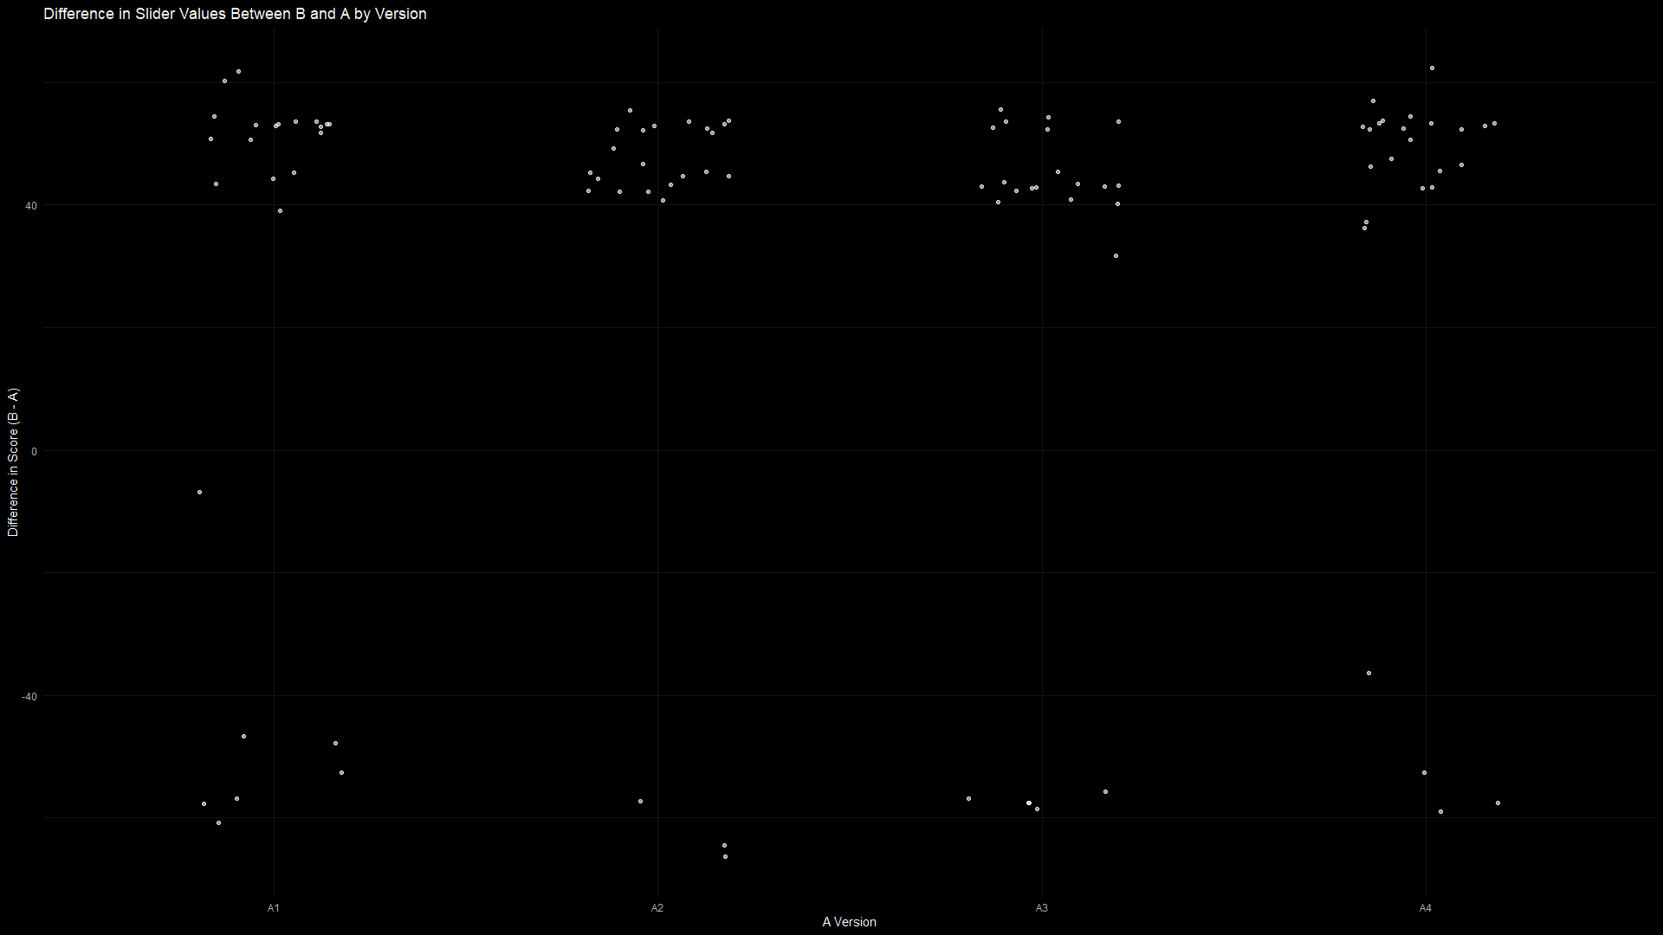

Slide 7
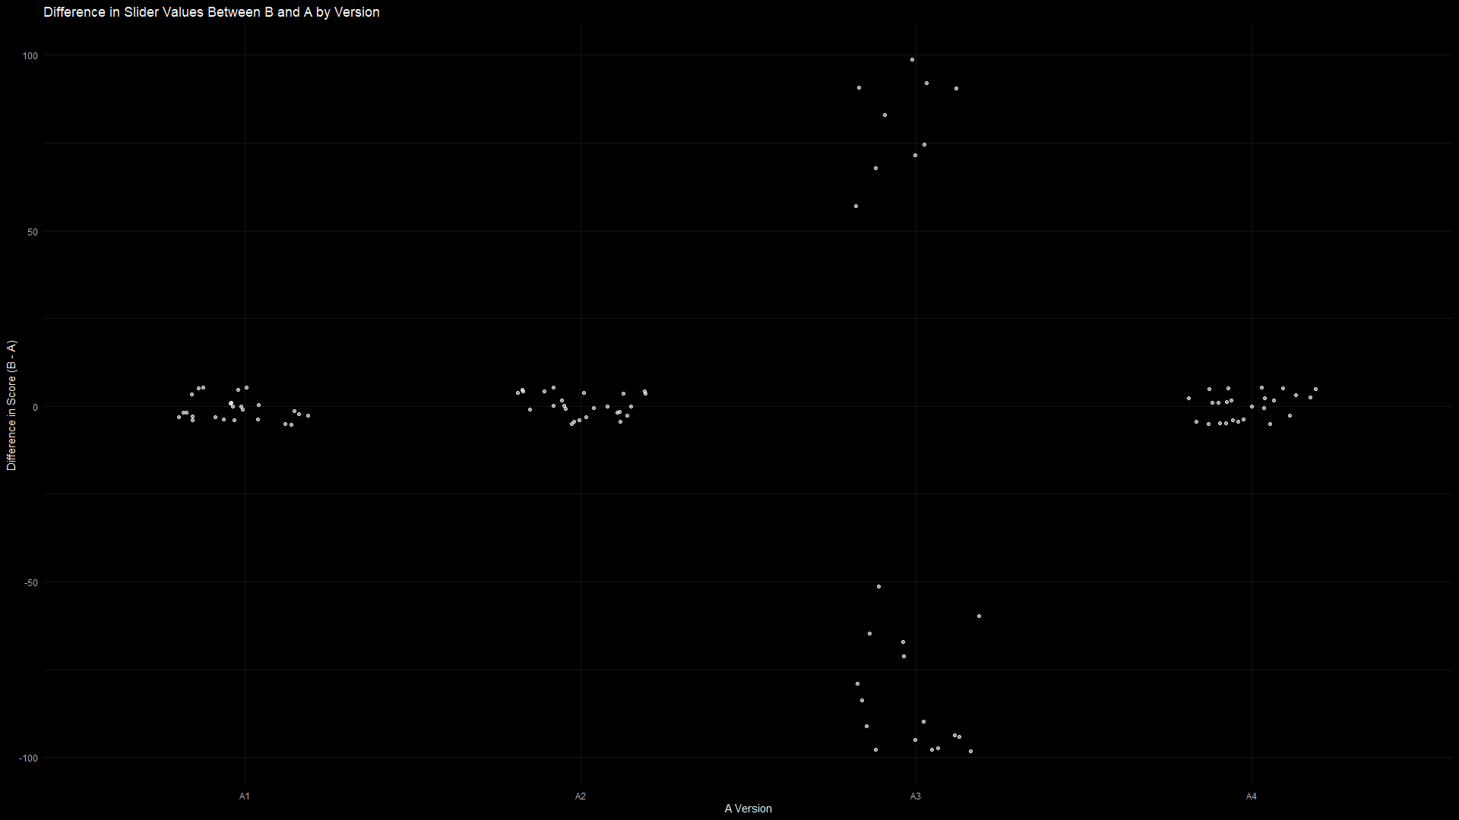

Slide 8
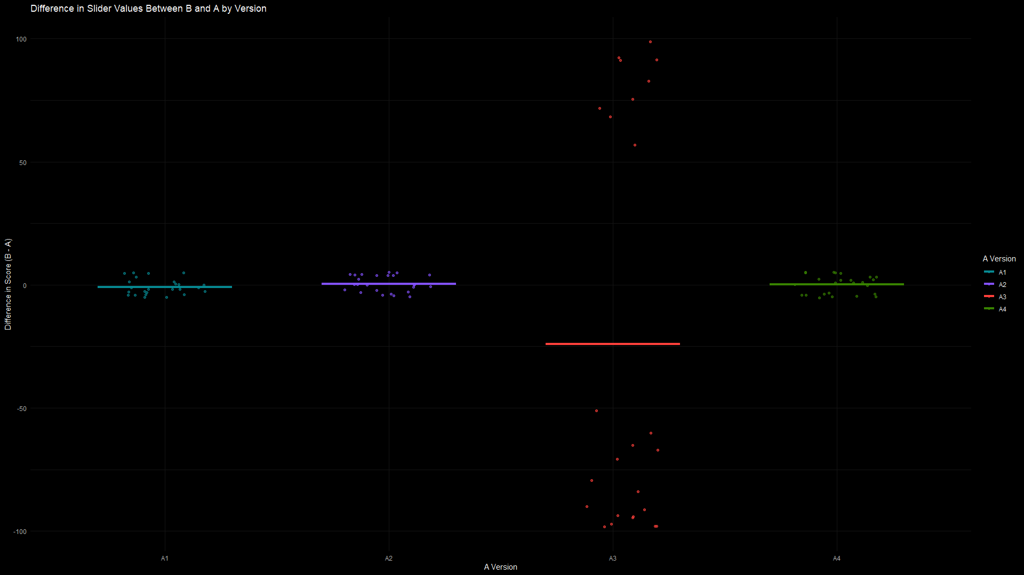

Slide 9
